Slide 1
Amazon Sales Analysis
Digvijay Nalavade
Rituparna Addy
Wire Frame

Slide 2
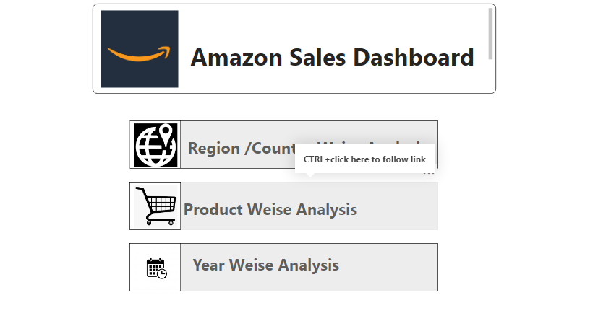

Slide 3
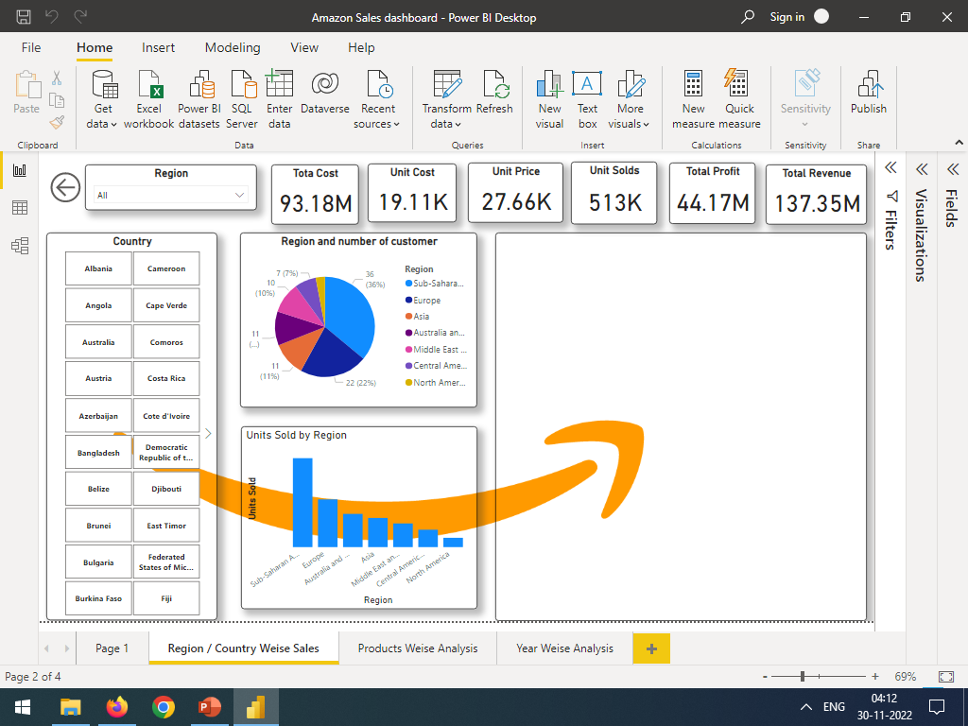

Slide 4
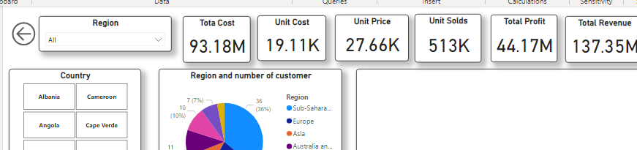
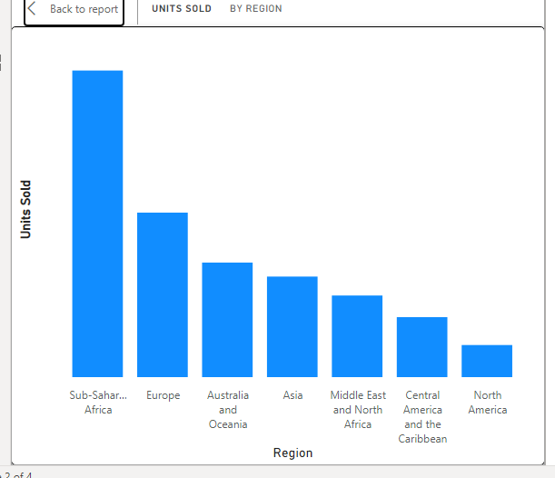
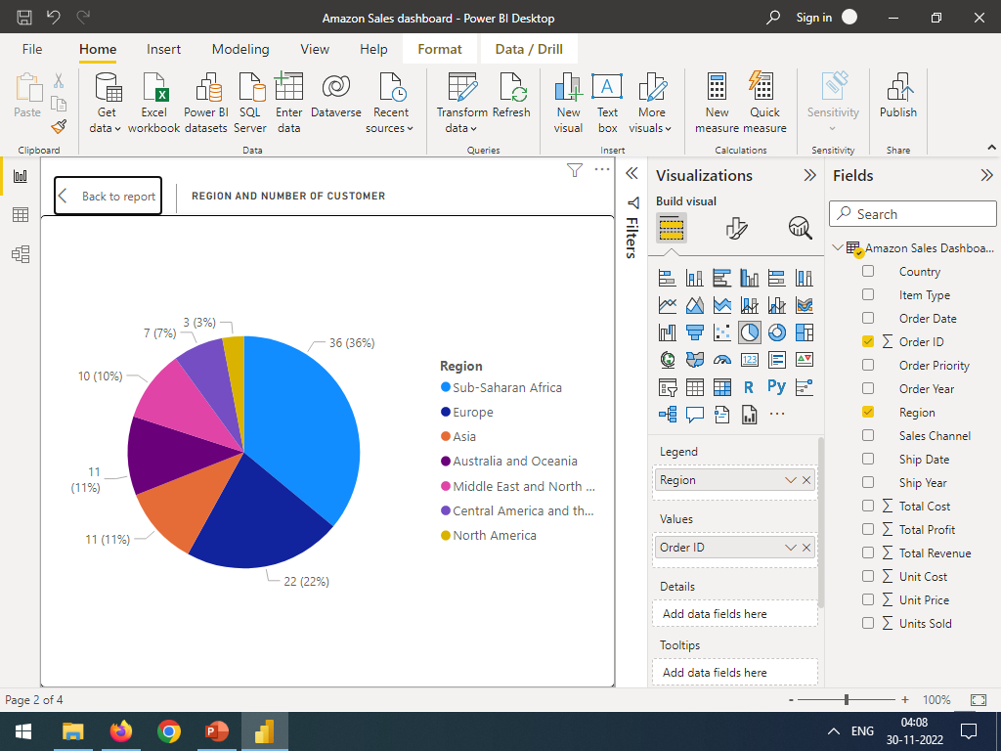
Slicer
Total Unit sold Region
Total profit product wise

Slide 5
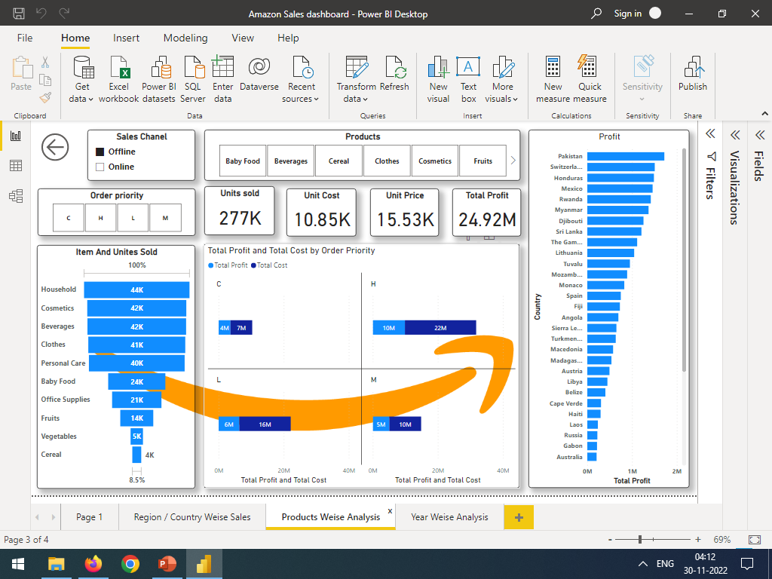

Slide 6
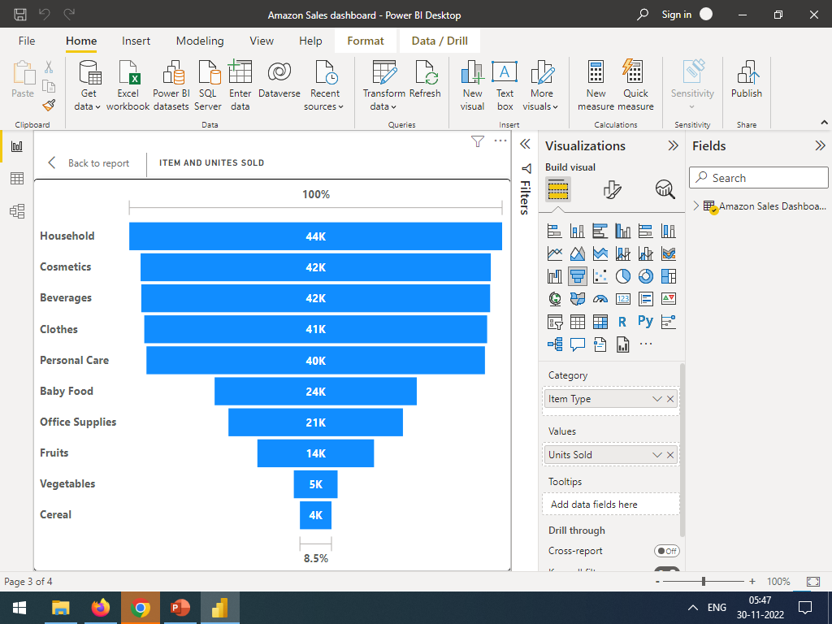
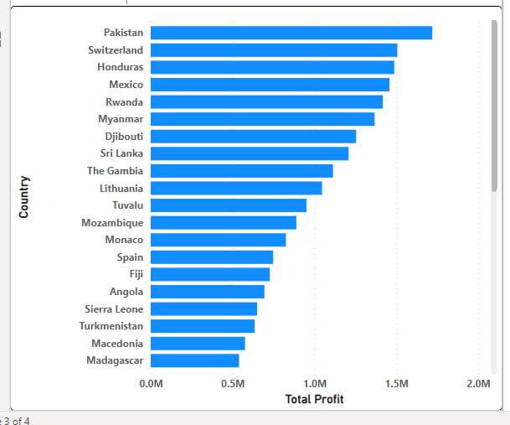
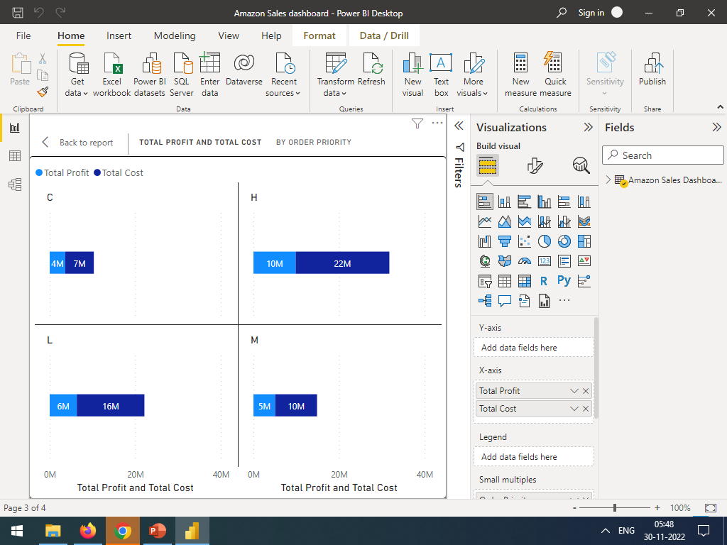
Slicer
Item an Unit sold
Country wise product sold
Order priority wise profit

Slide 7
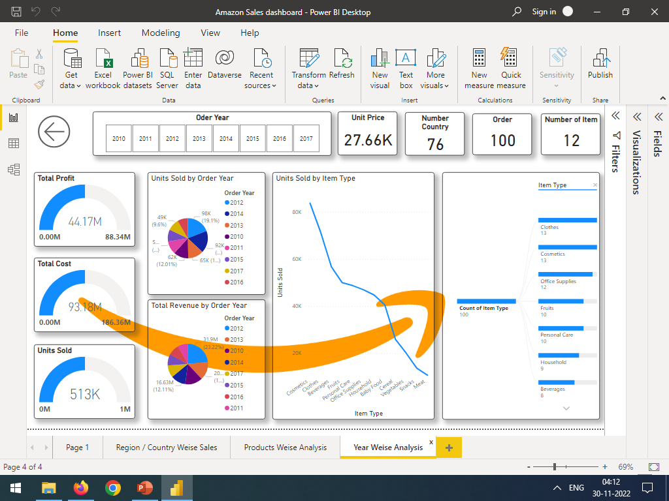

Slide 8
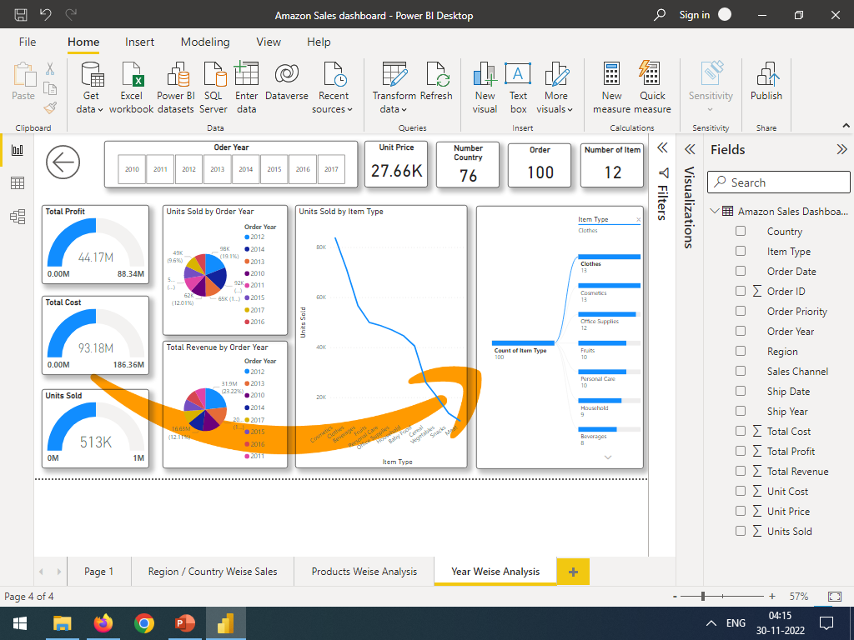
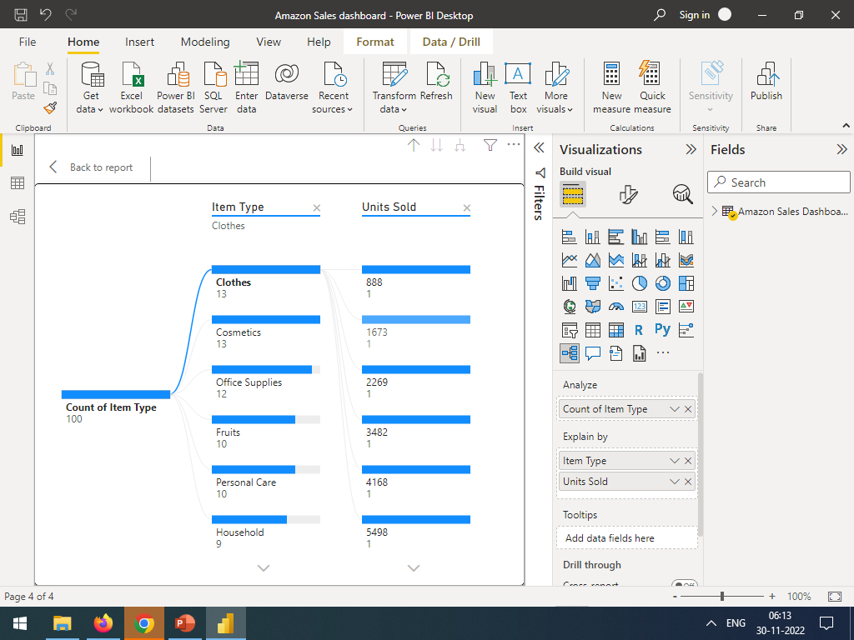
Gauge chart of product
Year wise unit sold
Unit sold by item type
Item and Sub category of items

Slide 9
THANK YOU

